Slide 1




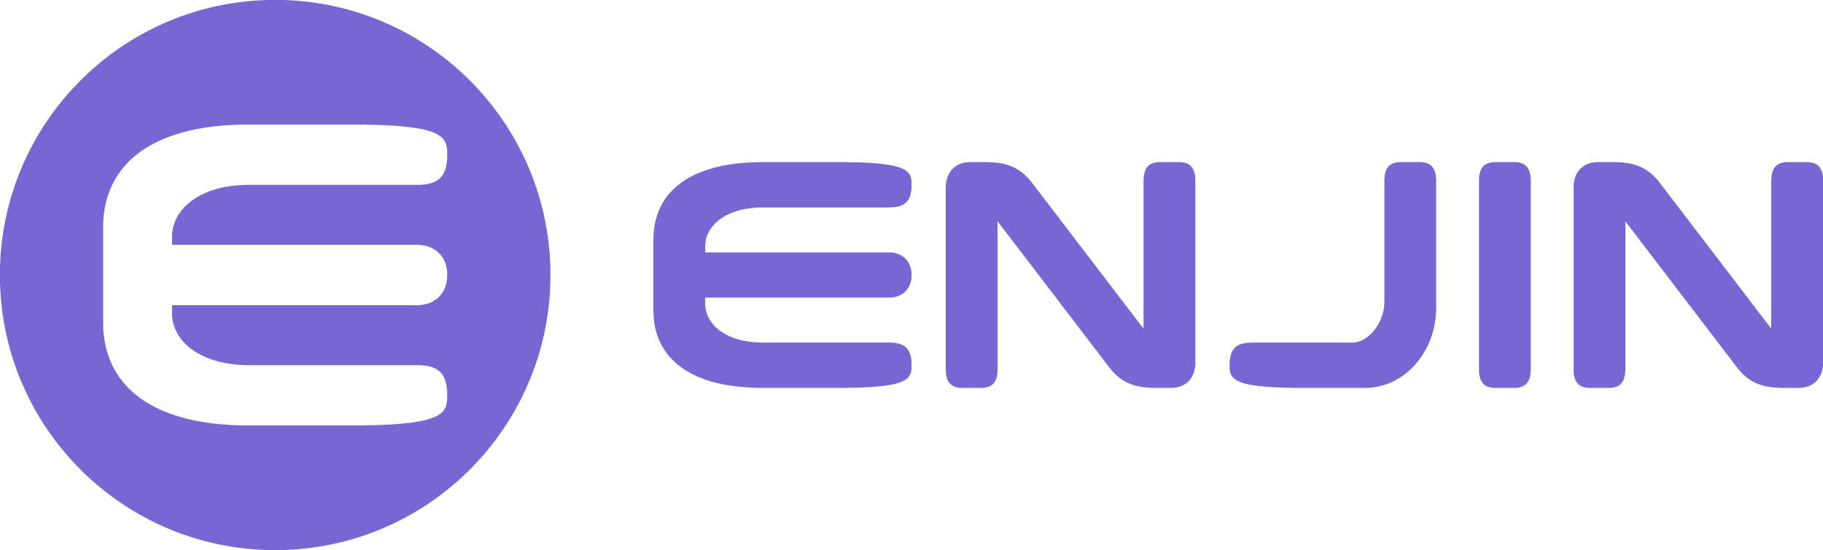
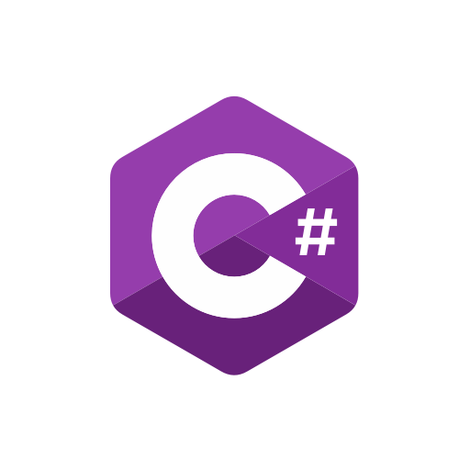

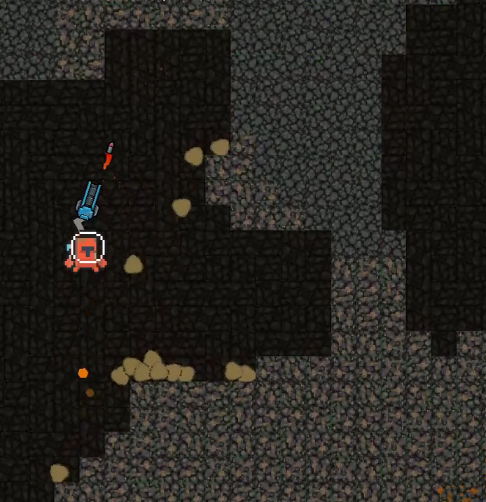
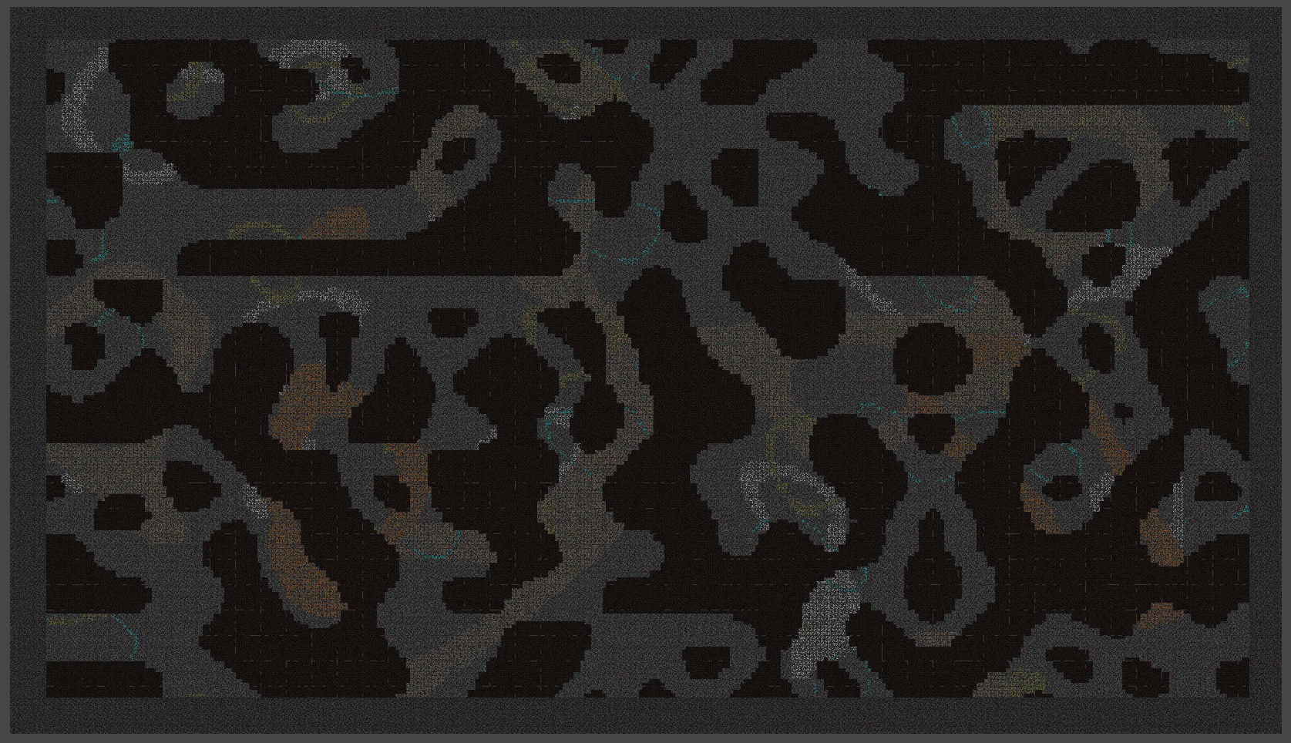
Cavebound (Crypto-Miner) Andrew Greenslade : https://www.linkedin.com/in/andrew-greenslade andrew@greensladegames.com AndrewGreenslade : https://github.com/AndrewGreenslade
1. Introduction:
2. Project objective
Cryptocurrency and NFTs as a reward in games are both widely unexplored mechanisms up to this date. There has been a small investment from mainstream studios, e.g. Ubisoft with ‘Ubisoft quartz’, where you could unlock limited access NFTs that would reward the player with unique game items. This leaves an upcoming market for various ways to integrate these two technologies into the industry. I aim to implement a similar system into my game called Cavebound, which is a procedurally generated 2D mining game built from the ground up around this system.
With this project, I aim to look at different ways of integrating NFT and cryptocurrency technologies into games and choose to integrate one method into this project that I have designed to be fun and rewarding for its players. I also aim to look at different tools and techniques I have never used before to make this game, so it is a learning experience throughout the whole process. These include random world generation, pathfinding with destructible terrains, AI pathfinding, using gizmos for debugging and testing, etc.
3. Technologies used
4. How I handled creating accounts in game
The way I handled accounts in the game was to generate a QR code and unique six-digit code/pin to allow the user to pair the account and project to their Enjin wallet, which is a proprietary Crypto & NFT wallet I chose to use. This is done using the SDK they provide for different game engines like Unity, unreal, etc.
5. what cryptocurrency did I use ?
6. How will they earn the cryptocurrency
The crypto exchange I have based this project on is the Goerli Testnet exchange, which is the test net for testing projects on an Ethereum blockchain. This will allow me to test functionality like earning and selling crypto for in-game items. This is all without spending anything. The only downfall is you can only add 10 Goerli coins every 10 minutes.
The end user will earn crypto for every game they play. They will earn a set amount, maybe 0.25, 0.5 Goerli coin based on feedback, which can be fine-tuned.
The earning will take place once at the end of a round which takes around 10 minutes currently.
This could then be spent hypothetically on in game unlocks like skins, upgrades,etc, using the SDK provided.

